Slide 1
DataQuest 2018
Road Safety
Team Name - Alpha_Omega
Indian Institute of Technology, Roorkee

Slide 2
Problem Statement
What are we supposed to do ?
How to increase the road safety ?
We have to come up with a predictive model which, using features related to accident, can be used to measure the criticality of the accident, such that the insights gained from the model can be used to make data-driven decisions to improve road safety in Dehradun, and with some modifications, hopefully in other areas as well.
The patterns hidden inside the data can be used to make better decisions and improve road safety. We have to use data of accidents that took place in the city of Dehradun, in order to come up with actionable insights and suggestions.
Identify the factors that majorly affect the occurence of an accident and design safety norms giving those factors priority.

Slide 3
Strategy
Data Wrangling:
Extracting month and year to analyse monthly and yearly patterns
Extracting hour and weekday to analyse hourly variations
Feature Engineering:
Created features to extract seasonal dependence.
Analyze, Identify Patterns, and Explore the Data.
Forward Selection
Model, predict and solve the problem.

Slide 4
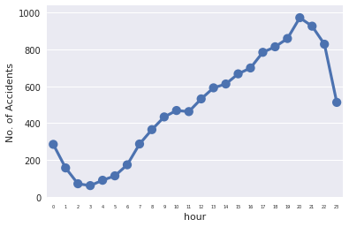
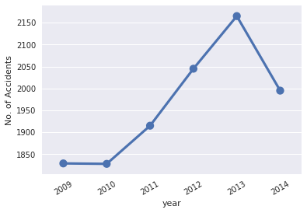
Variation of Accidents with Time

Slide 5
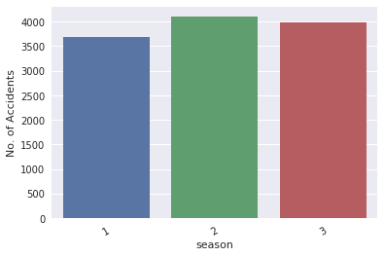
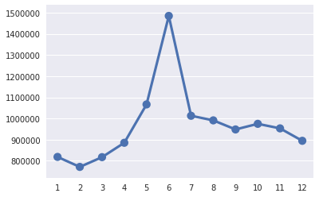
Variation of accidents with season
Source : Government Tourism Data

Slide 6
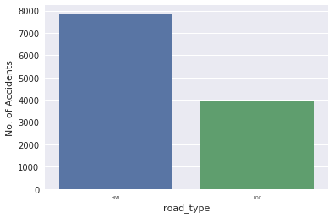
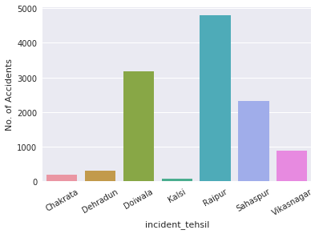
Variation of accidents with other factors

Slide 7
Ideas for further Improvement
Including features which can be determined before accident
Scope for better data (weather, road, satellite images etc).
Developing a cognitive environment for Traffic Police which can locate accident prone areas, so that resources can be utilised more efficiently

Slide 8
Thank You

